Slide 1

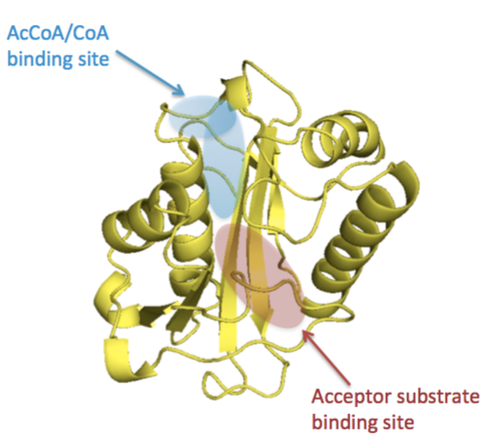
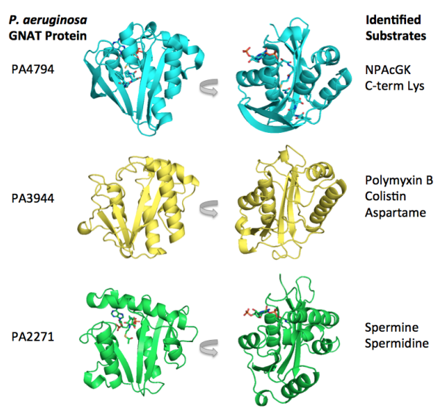
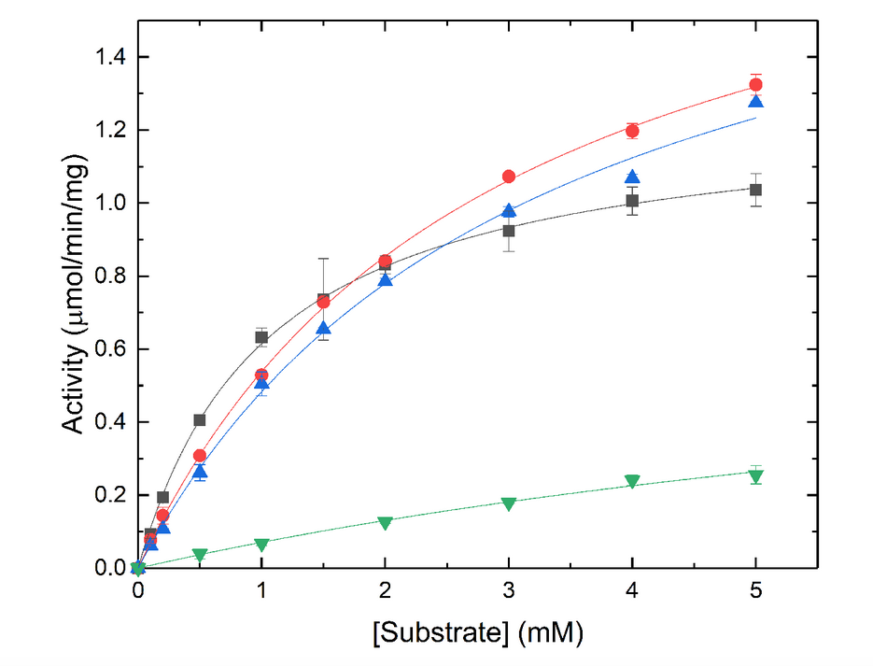
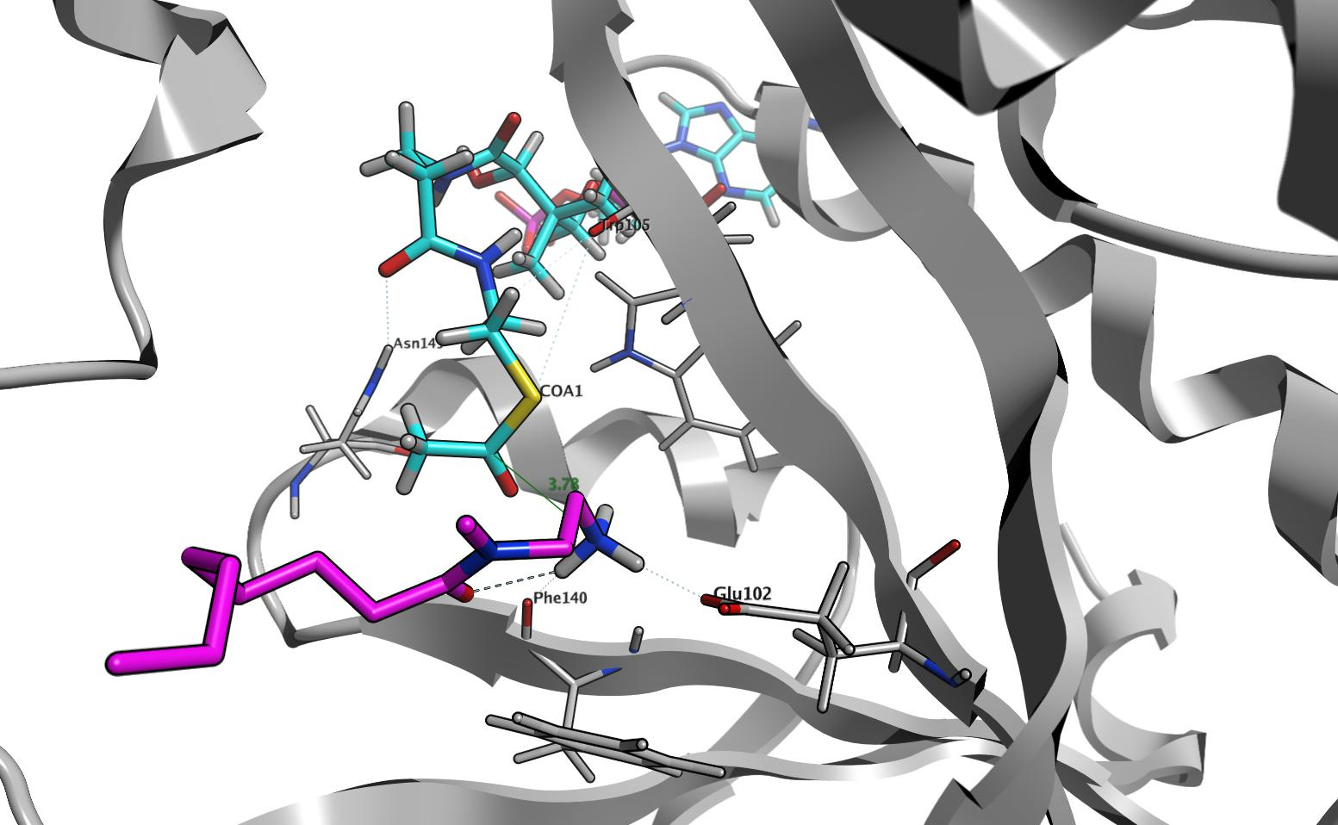
Synthesis of GNAT PA3944 Substrate Analogs
Madison Anonick¹, Thahani S. Habeeb Mohammad¹, Cory Reidl¹, Xhulio Arolli¹, Misty Kuhn², and Daniel P. Becker¹
¹Department of Chemistry and Biochemistry, Loyola University Chicago, Chicago, IL 60660, USA; ²Department of Chemistry and Biochemistry, San Francisco State University, San Francisco, CA 94132, USA.
The Gcn5-related N-acetyltransferase (GNAT) superfamily is responsible for diverse biological functions and is critically important in cellular and metabolic processes in all kingdoms of life. GNATs transfer an acetyl-group from an active donor, typically acetyl-coenzyme A (AcCoA), to a primary amine of an acceptor substrate. Members of this family are well known for their roles in aminoglycoside antibiotic resistance, histone modification, protein acetylation, xenobiotic metabolism, and other cellular processes.^{1, 2} A small subset of bacterial GNAT enzymes have been studied and characterized both structurally and functionally, but the function of the vast majority remains unknown. Most of the reported 3D crystallographic structures of GNATs contain no acceptor substrate bound in their active sites. We previously screened the PA3944 protein against a panel of potential substrates and found the enzyme exhibited the highest activity toward aspartame, polymyxin B and colistin (polymyxin E).³ Our project involves the synthesis of molecular analogs of previously identified functionally relevant acceptor substrates that will be co-crystallized with GNAT-PA3944, in particular simplified derivatives of polymyxin B including NANMO and AAB, and we have shown that NANMO is as efficient as polymyxin B as a substrate. The ligand-bound crystallographic structures will provide insight into the structural features of the active site that are involved in substrate recognition and advance our understanding of types of substrates recognized by this enzyme of unknown function. Syntheses of NANMO and AAB will be described, along with modeling and substrate efficiency.
Background
Synthesis of small molecule analogs of Polymyxin B
The Gcn5-related N-acetyltransferase (GNAT) superfamily play a role in many biological and cellular functions including histone modification and amino glycoside antibiotic resistance. The main chemical function of GNAT enzymes is acetyl transfer from a donor substrate to the acceptor bound in an adjacent binding pocket to the donor bonding pocket (Figure 1). Typically, the donor substrate is Acetyl-CoA and acceptor substrates include polyamines such as polymyxin B, antibiotics, and other biomolecules. The 3D crystallographic structure obtained through co-crystallizing a ligand with the enzyme is a powerful tool in identifying the ligand binding site residues through which modern computer simulations may help predict protein functions or modes of ligand binding. Our collaborator, Dr. Misty Kuhn has identified acceptor substrates for the PA4794, PA3944, and PA2271 GNAT enzymes using a broad-substrate screening assay. The goal of our project is to crystallize these enzymes with both an acceptor substrate and donor substrate bound to reveal the active site structure and biological function of our specific enzyme GNAT PA3944.
Figure 3. Structures of macrocyclic antibiotics polymyxin B and colistin, with Dab-3 moiety shown in red.
Figure 2. Identified substrates through broad-substrate screening assay for three classes of GNAT.
The NANMO and AAB substrates were designed to mimic the diamino butyrate (Dab) group of polymyxin B and Colistin. NANMO synthesis shown below (scheme 1) has been completed and the substrate was used in an affinity assay with the enzyme. The synthesis of AAB is ongoing.
Figure 1. General location of the AcCoA/CoA (blue) and acceptor (pink) substrate binding sites for GNATs.
Scheme 1. Synthesis of N-(2-aminoethyl)-N-methyloctanamide TFA salt (NANMO).
Results/Discussion
The substrate NANMO, was used in an assay with the enzyme, GNAT PA3944 demonstrating that the activity towards NANMO is similar to enzymatic activity toward the antibiotic Polymyxin B. Comparison between the activities of the two substrates can be seen in Figure 4. The structural similarity between Polymyxin B, Colistin, and NANMO is the Dab-3 structure shown in red in Figure 3. This part of the substrate binds to the active site in GNAT PA3944 which allows us to predict which residues are binding to the enzyme to determine structure (Figure 5).
Scheme 2. Synthesis of 2-acetamido-6-amino-N-benzylhexanamide (AAB).
Figure 4. The substrate saturation curve of an assay ran with PA3944 and NANMO. Black squares are NANMO, red circles are colistin, blue triangles are polymyxin B, green triangles are the free amino acid Dab.
Future Work:
We have designed and are currently synthesizing substrates to improve interactions with GNAT PA3944 in order to obtain a X-ray crystal structure of GNAT PA3944 with both Acetyl CoA and an acceptor substrate bound in the active sites. The crystal structures will allow us identify active site residues involved in the substrate identification and binding and to characterize the enzyme functionally. The next proposed substrate is benzyl (S)-(4-amino-1-(methylamino)-1-oxobutan-2-yl)carbamate (BAMOC) and the synthesis is demonstrated in scheme 3.
Figure 5. Predicted interactions between NANMO and the active site residues in GNAT PA3944 with Acetyl CoA bound as donor substrate.
References:
1. L. Favrot, J. S. Blanchard and O. Vergnolle, Biochemistry (N. Y.), 2016, 55, 989-1002.
2. K. L. Hentchel and J. C. Escalante-Semerena, Microbiol. Mol. Biol. Rev., 2015, 79, 321-346.
3. Reidl, C. , et. al. FEBS Lett. 2017, 591, 2348-2361.
4. John, A., Capra, R. A., et. al. PLoS Comput Biol. 2009, 5, 1000585.
5. Majorek, K.A., Kuhn, M.L., et. al. J. Biol. Chem. 2013, 288, 30223-30235.
Scheme 3. Synthesis of benzyl (S)-(4-amino-1-(methylamino)-1-oxobutan-2-yl)carbamate (BAMOC) .
Notes:
Trying to mimic polymyxin B tail in the substrate. Run the assay, see how tightly the substrate bounds, co-crystallize the substrate with the GNAT PA3944
Substrate efficiency
Protonated amine and asp

